Slide 1



FLDSMDFR
FROM LEARNERS TO DEVELOPERS: SOFTWARE, MECHATRONICS, DATA, FINDINGS & RESEARCH
HOME
ABOUT US
INFORMATION
A WORLD AWAY: HUNTING FOR EXOPLANETS WITH AI
FLDSMDFR

Slide 2



FLDSMDFR
HOME
ABOUT US
INFORMATION
METHODOLOGY
COMBINE THE THREE MISSIONS, WHICH WILL ALLOW:
Train a general model that learns common patterns across missions.
Evaluate if certain missions introduce biases.
Filter or do cross-validation by mission if you wish later.

Slide 3
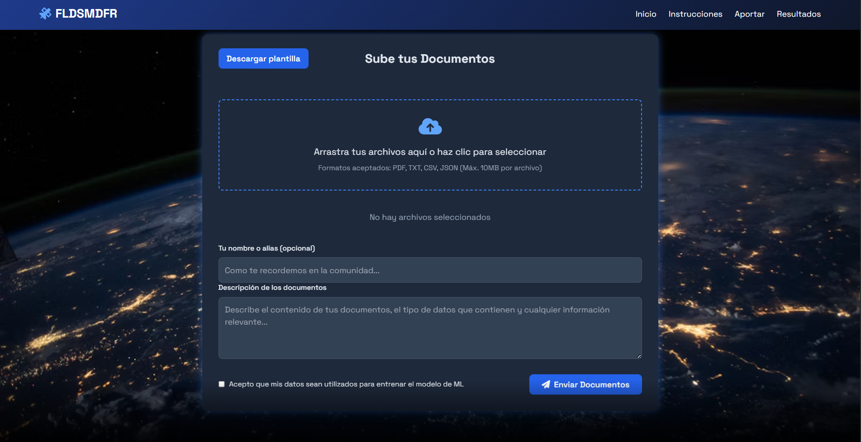

Slide 4


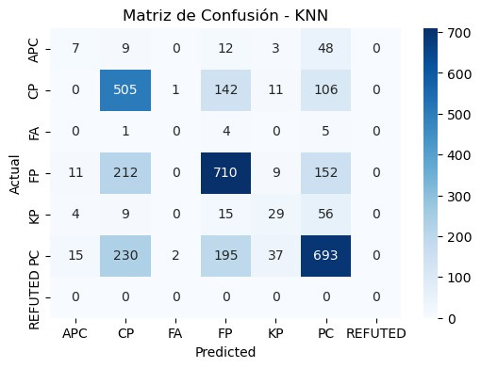
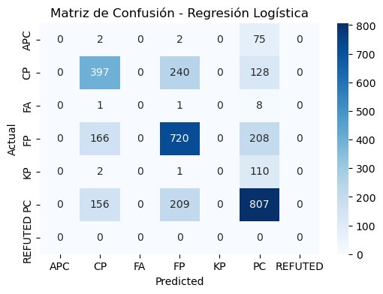
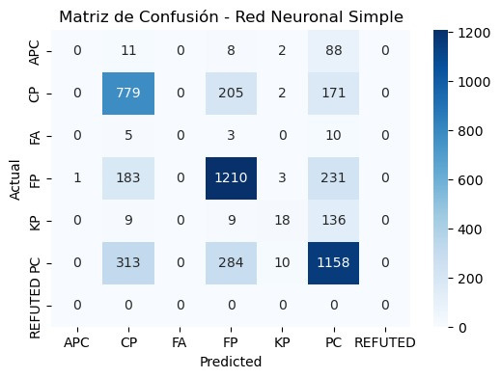
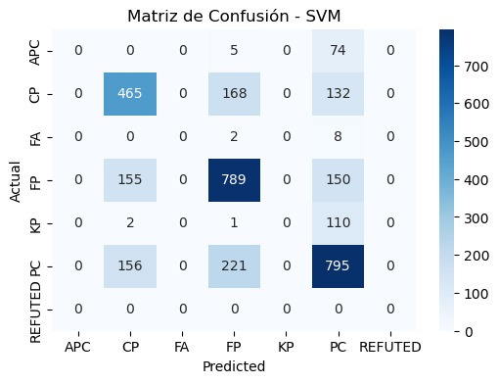
FLDSMDFR
HOME
ABOUT US
INFORMATION
APPROACH:
Combine the three missions, which will allow:
Train a general model that learns common patterns across missions.
Evaluate if certain missions introduce biases.
Filter or do cross-validation by mission if you wish later.
Training a large multi-classification model generated the same noise in both classical models (like logistic regression or KNN) and neural networks, due to their similarities, plus the fact that in refuted it only has 2 data points after removing nulls, so the ideal was to maintain 3 key classifications

Slide 5
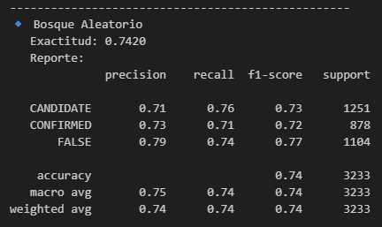
FLDSMDFR
HOME
ABOUT US
INFORMATION
RESULTS:
RANDOM FOREST
The Random Forest model was chosen not only for its overall accuracy but also for its high precision in identifying the FALSE class, which helps to avoid false dismissals of potentially valid cases.

Slide 6
Result | Meaning | Use / Implication
CONFIRMED ✅ | Object verified as a real exoplanet | High reliability; useful for scientific studies and follow-up
CANDIDATE 🟡 | Possible exoplanet; requires additional confirmation | Prioritize for future observations or analyses
FALSE POSITIVE ❌ | Object is not an exoplanet; signal caused by other phenomena or errors | Avoids unnecessary analysis; focuses resources on real candidates

Slide 7
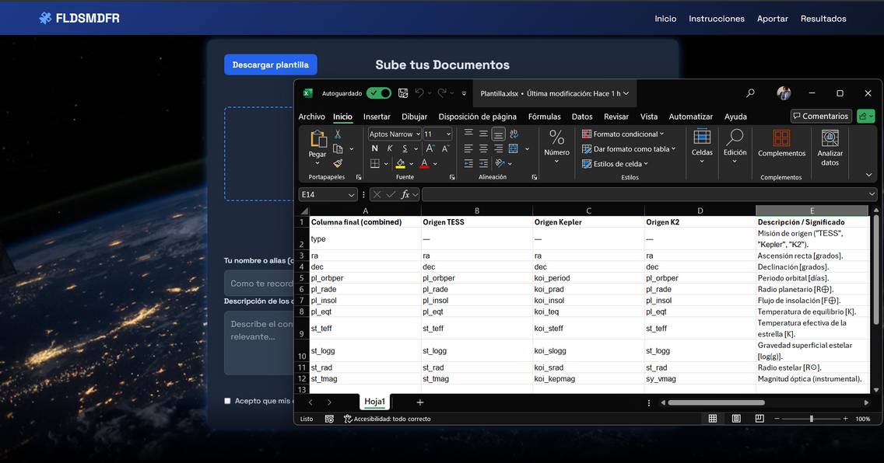
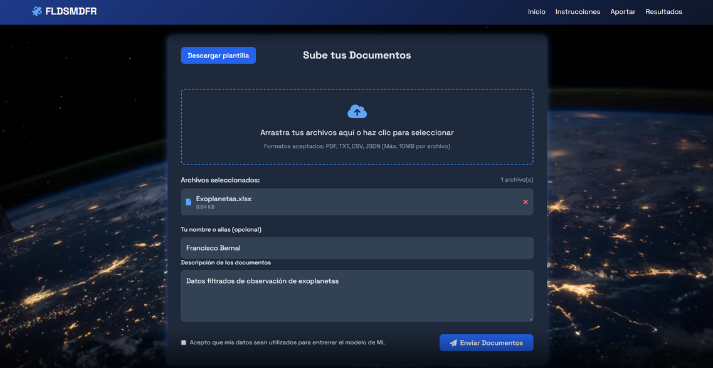
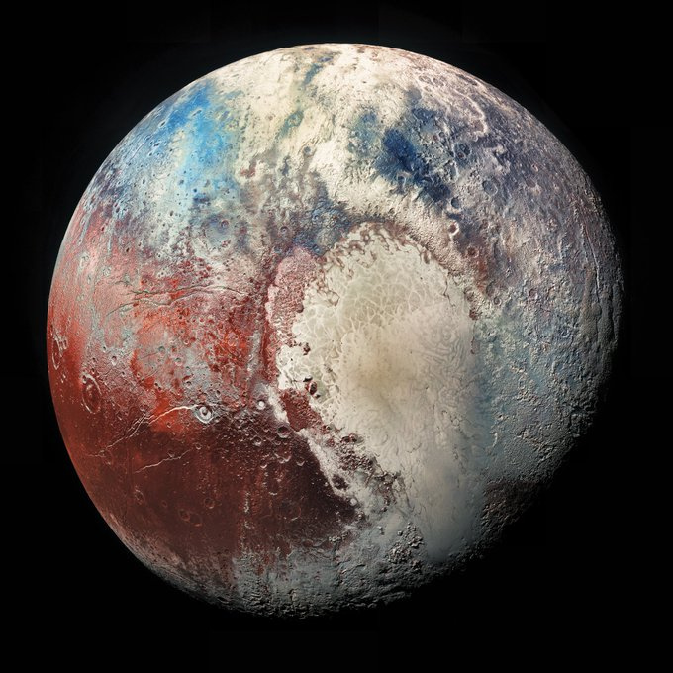
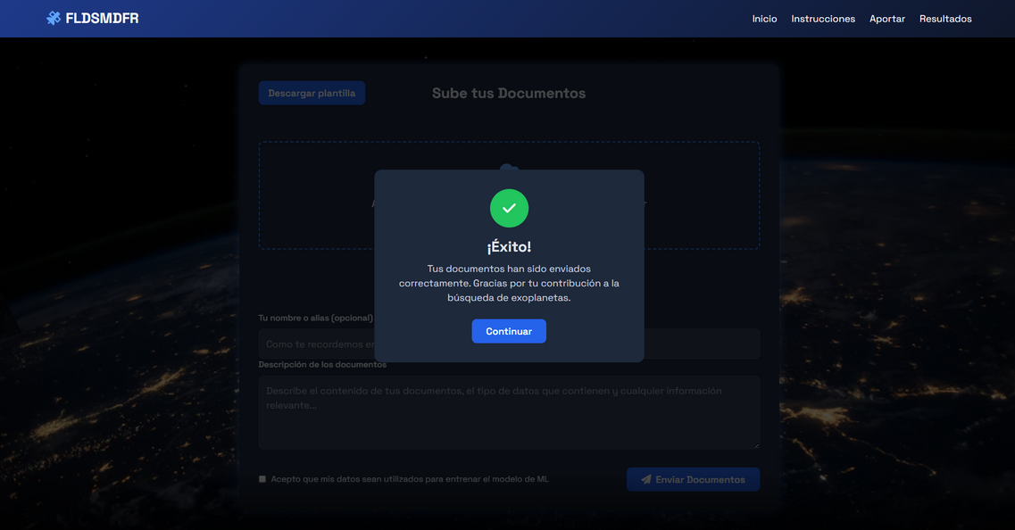
FLDSMDFR
HOME
ABOUT US
INFORMATION
HOW TO CONTRIBUTE TO ML TRAINING
A template is provided for individuals to place their filtered data, the backend selects the data and saves it in the database to train the ML, all documents, user, and data are stored in specific tables.

